Slide 1

GOVERNMENT COLLEGE OF ENGINEERING BARGUR (AUTONOMOUS)
PROJECT TITLE: COVID – 19 CASES ANALYSIS
TEAM MEMBERS:
SHALOME A
BALAJI S
KAMALAKANNAN V
THANGARAJ S
VARUN KUMAR M

Slide 2

PROBLEM STATEMENT:
The project aim is to continue building the project by performing different activities like feature engineering, model training, evaluation etc as per the instructions in the project.

Slide 3
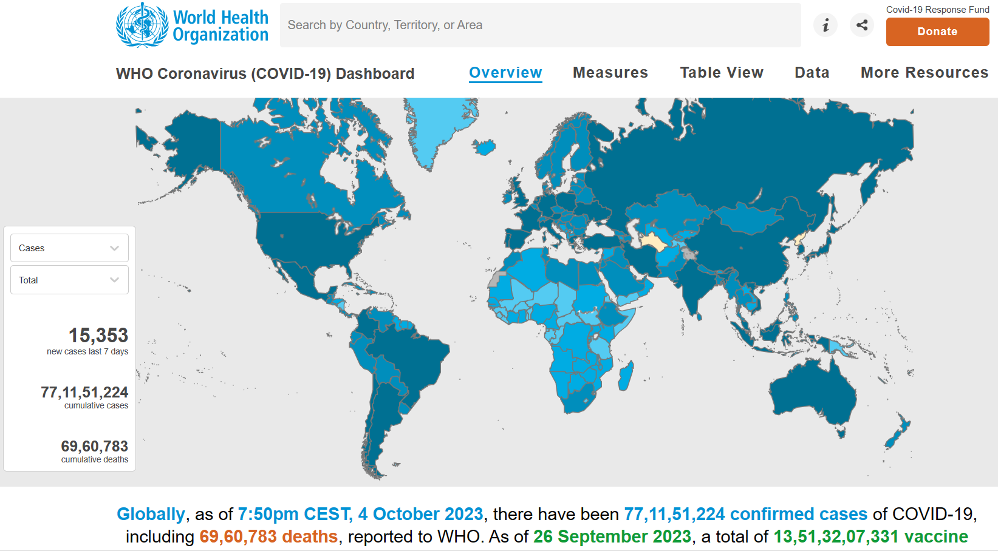

Slide 4
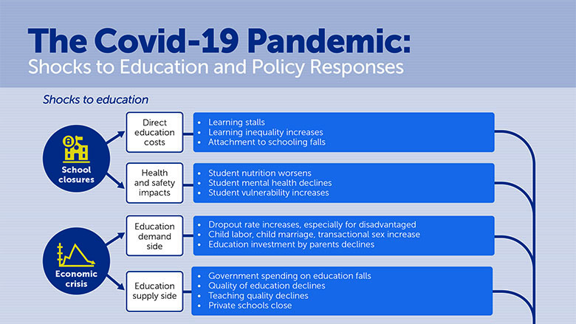
PROJECT OVERVIEW:
This project involve a combination of data modeling, report building, and potentially custom scripting depending on your specific requirements. Below is a simplified example of the process. Note that this is a high-level overview, and actual code would depend on your data source and the specific analysis you wish to perform. Also, IBM Cognos uses its own scripting language called "Cognos Expressions" for report development.

Slide 5
DATA ANALTICS OUTLINE:
Data Connection Setup:
In Cognos, we can set up a data connection to your COVID-19 dataset. We would define data source details such as the database or file location, connection credentials, and any required SQL queries to retrieve the data.
Data Modeling:
In IBM Cognos, we can use IBM Framework Manager to create a data model. This involves defining the structure of our data, such as tables, relationships, calculations, and business rules. This is where we specify how COVID-19 data relates to other data sources if necessary.
Report Development:
Cognos allows you to design reports and dashboards using a drag-and-drop interface. We can create various types of visualizations like tables, charts, and maps to present COVID-19 data. The code would mostly involve creating and formatting these reports.

Slide 6
Here's a simple example of how we might create a report in Cognos to display daily new cases:
- Create a new report
- Drag the "Date" dimension to the Rows section
- Drag "New Cases" measure to the Columns section
- Apply necessary formatting and calculations
- Add titles, labels, and a date range filter
Data Analysis:
Cognos provides various functions and expressions to perform calculations and aggregations on our data. For instance, we can calculate rolling averages, growth rates, or percentage changes in cases. The code for data analysis will depend on the specific calculations we want to perform.
Geospatial Analysis:
If we wish to include geographic analysis, Cognos can handle geospatial data. We might write code to create a map visualization showing COVID-19 hotspots or trends in different regions.

Slide 7
Automation and Scheduling:
Cognos allows us to schedule data refreshes and report distribution. We would set up schedules and configurations using the Cognos administration interface.
Custom Scripting:
Depending on our requirements, we may need to write custom scripts. Cognos uses its own scripting language for expressions, but we can also integrate with external data sources and perform custom scripting in languages like JavaScript if needed.
Security and Compliance:
In Cognos, we'd configure security settings and data access permissions to ensure that sensitive data is protected.
Remember that creating a full COVID-19 analysis project in Cognos is a detailed process, and it's important to have a good understanding of Cognos tools and features, as well as a clear project plan to meet our objectives.

Slide 8
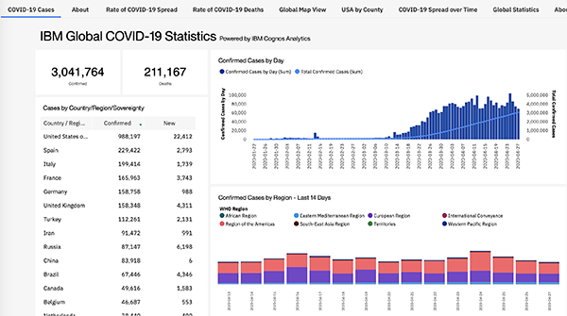

Slide 9
PROCEDURE:COVID-19 ANALYSIS IN PYTHON:
Step 1: Install Required Libraries
Eg: pip install pandas matplotlib seaborn scikit-learn
Step 2: Prepare the Data
Obtain COVID-19 data in CSV format.
Save the data file (e.g., covid_data.csv) in the same directory as your Python script
Step 3: Python Script
Use any code editor or integrated development environment (IDE) to create and run the Python script.
Step 4: Running the Script
Save and run the script
The script will load the data, perform analysis, and display the visualizations and results as specified in the code.
Review the output and adapt the code as needed for your specific analysis goals.

Slide 10

PYTHON CODE:
To perform COVID-19 data analysis in Python, we can use libraries such as pandas for data manipulation, matplotlib and seaborn for data visualization, and scikit-learn for machine learning.

Slide 11
Covid cases analysis.py
import pandas as pd
import matplotlib.pyplot as plt
import seaborn as sns
data = [
{
'dateRep': '31-05-2021',
'day': 31,
'month': 5,
'year': 2021,
'cases': 366,
'deaths': 5,
'countriesAndTerritories': 'Austria'
},

Slide 12
{
'dateRep': '30-05-2021',
'day': 30,
'month': 5,
'year': 2021,
'cases': 570,
'deaths': 6,
'countriesAndTerritories': 'Austria'
},
{
'dateRep': '29-05-2021',
'day': 29,
'month': 5,
'year': 2021,
'cases': 538,
'deaths': 11,
'countriesAndTerritories': 'Austria'
},

Slide 13
{
'dateRep': '28-05-2021',
'day': 28,
'month': 5,
'year': 2021,
'cases': 639,
'deaths': 4,
'countriesAndTerritories': 'Austria'
},
{
'dateRep': '27-05-2021',
'day': 27,
'month': 5,
'year': 2021,
'cases': 405,
'deaths': 19,
'countriesAndTerritories': 'Austria'
},

Slide 14
{
'dateRep': '26-05-2021',
'day': 26,
'month': 5,
'year': 2021,
'cases': 287,
'deaths': 8,
'countriesAndTerritories': 'Austria'
},
{
'dateRep': '25-05-2021',
'day': 25,
'month': 5,
'year': 2021,
'cases': 342,
'deaths': 3,
'countriesAndTerritories': 'Austria'
}

Slide 15
# Convert the data into a DataFrame
df = pd.DataFrame(data)
plt.figure(figsize=(12, 6))
sns.lineplot(data=df, x='dateRep', y='cases')
plt.title('Daily Cases Over Time')
plt.xticks(rotation=45)
plt.show()
plt.figure(figsize=(12, 6))
sns.lineplot(data=df, x='dateRep', y='deaths')
plt.title('Daily Deaths Over Time')
plt.xticks(rotation=45)
plt.show()
plt.figure(figsize=(8, 6))
sns.scatterplot(data=df, x='cases', y='deaths')
plt.title('Scatter Plot of Cases vs. Deaths')
plt.show()
correlation = df['cases'].corr(df['deaths'])
print(f'Correlation between cases and deaths: {correlation}')

Slide 16
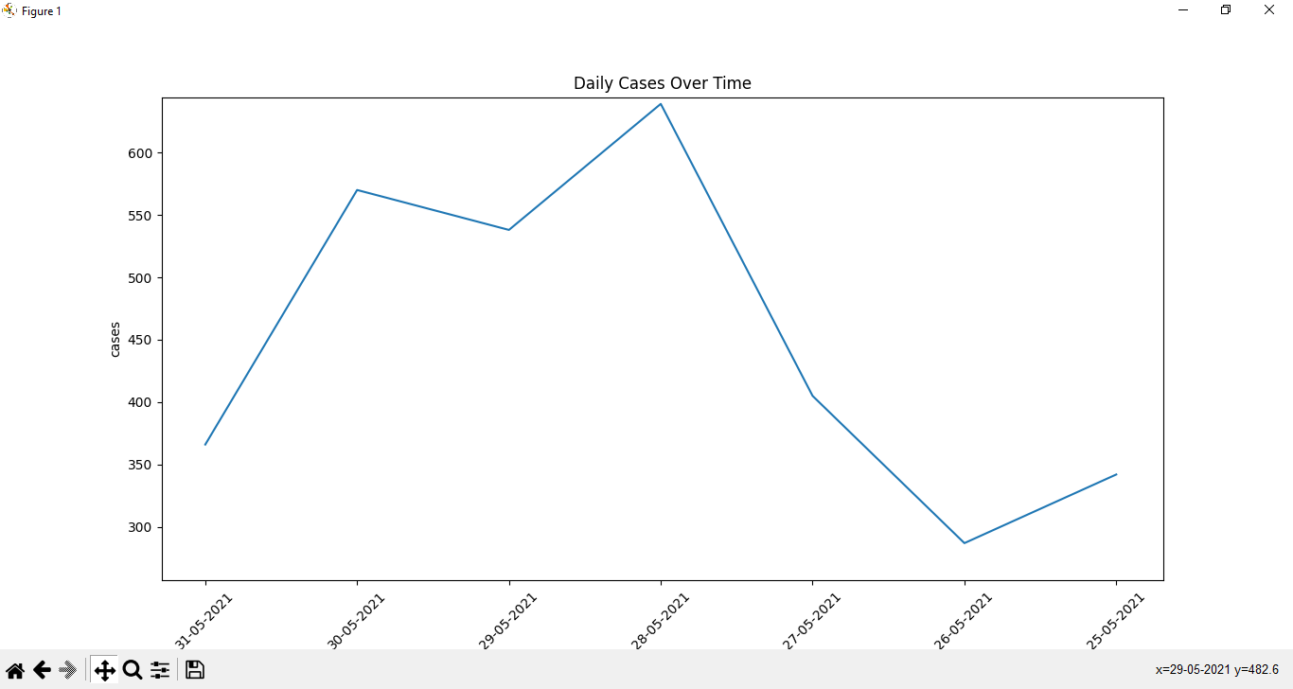
OUTPUT

Slide 17


